Slide 1
Core Java (Access Modifier)
By Vijay Kumbhar

Slide 2
Private: The access level of a private modifier is only within the class. It cannot be accessed from outside the class.
Default: The access level of a default modifier is only within the package. It cannot be accessed from outside the package. If you do not specify any access level, it will be the default.
Protected: The access level of a protected modifier is within the package and outside the package through child class. If you do not make the child class, it cannot be accessed from outside the package.
Public: The access level of a public modifier is everywhere. It can be accessed from within the class, outside the class, within the package and outside the package.

Slide 3
Access Modifier | within class | within package | outside package by subclass only | outside package
Private | Y | N | N | N
Default | Y | Y | N | N
Protected | Y | Y | Y | N
Public | Y | Y | Y | Y

Slide 4
1) Private
The private access modifier is accessible only within the class.
class B{
private int data=40;
private void msg(){System.out.println("Hello java");}
}
public class Simple{
public static void main(String args[]){
B obj=new B();
System.out.println(obj.data);//Compile Time Error
obj.msg();//Compile Time Error
}
}

Slide 5
Private Constructor
Role of Private Constructor
If you make any class constructor private, you cannot create the instance of that class from outside the class.
Eg:
class A{
private A(){}//private constructor
void msg(){System.out.println("Hello java");}
}
public class Simple{
public static void main(String args[]){
A obj=new A();//Compile Time Error
}
}

Slide 6
2) default
If you don't use any modifier, it is treated as default by default. The default modifier is accessible only within package. It cannot be accessed from outside the package. It provides more accessibility than private. But, it is more restrictive than protected, and public.

Slide 7
In the below example, the scope of class A and its method msg() is default so it cannot be accessed from outside the package
package abc;
class A{
void msg(){System.out.println("Hello");}
}
//save by B.java
package abc;
import pack.*;
class B{
public static void main(String args[]){
A obj = new A();//Compile Time Error
obj.msg();//Compile Time Error
}
}

Slide 8
3) Protected
The protected access modifier is accessible within package and outside the package but through inheritance only.
The protected access modifier can be applied on the data member, method and constructor. It can't be applied on the class.
It provides more accessibility than the default modifier.

Slide 9
Eg:
package test;
public class B{
protected void msg(){System.out.println("Hello");}
}
package test;
import test.*;
class Z extends B{
public static void main(String args[]){
Z obj = new Z();
obj.msg();
}
}

Slide 10
4) Public
The public access modifier is accessible everywhere. It has the widest scope among all other modifiers.
package test;
public class B{
public void msg(){System.out.println("Hello");}
}
-------
package mypack;
import pack.*;
class B{
public static void main(String args[]){
A obj = new A();
obj.msg();
}
}

Slide 11
Naming convention
Java naming convention is a rule to follow as you decide what to name your identifiers such as class, package, variable, constant, method, etc.
But it is not forced to follow. So, it is known as convention not rule. These conventions are suggested by several Java communities such as Sun Microsystems and Netscape.
All the classes, interfaces, packages, methods and fields of Java programming language are given according to the Java naming convention. If you fail to follow these conventions, it may generate confusion or erroneous code.

Slide 12
Identifiers Type | Naming Rules | Examples
Class | It should start with the uppercase letter. It should be a noun such as Color, Button, System, Thread, etc. Use appropriate words, instead of acronyms. | public class Employee { //code snippet }
Interface | It should start with the uppercase letter. It should be an adjective such as Runnable, Remote, ActionListener. Use appropriate words, instead of acronyms. | interface Printable { //code snippet }
Method | It should start with lowercase letter. It should be a verb such as main(), print(), println(). If the name contains multiple words, start it with a lowercase letter followed by an uppercase letter such as actionPerformed(). | class Employee { // method void draw() { //code snippet } }
Variable | It should start with a lowercase letter such as id, name. It should not start with the special characters like & (ampersand), $ (dollar), _ (underscore). If the name contains multiple words, start it with the lowercase letter followed by an uppercase letter such as firstName, lastName. Avoid using one-character variables such as x, y, z. | class Employee { // variable int id; //code snippet }
Package | It should be a lowercase letter such as java, lang. If the name contains multiple words, it should be separated by dots (.) such as java.util, java.lang. | //package package com.javatpoint; class Employee { //code snippet }
Constant | It should be in uppercase letters such as RED, YELLOW. If the name contains multiple words, it should be separated by an underscore(_) such as MAX_PRIORITY. It may contain digits but not as the first letter. | Class Employee { //constant static final int MIN_AGE = 18; //code snippet }

Slide 13
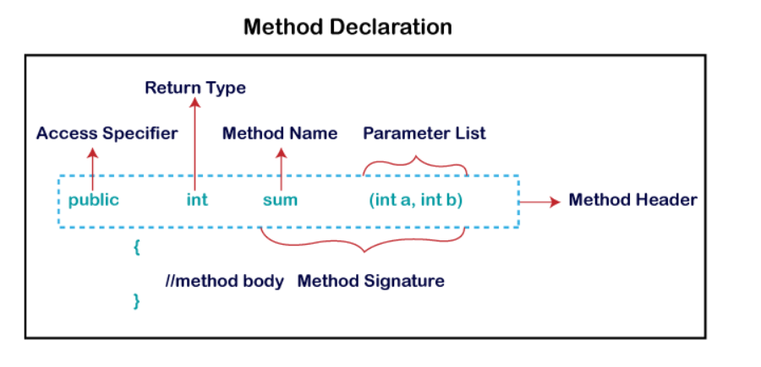
Method
A method is a block of code or collection of statements or a set of code grouped together to perform a certain task or operation. It is used to achieve the reusability of code. We write a method once and use it many times. We do not require to write code again and again. It also provides the easy modification and readability of code, just by adding or removing a chunk of code. The method is executed only when we call or invoke it.

Slide 14
Method Signature: Every method has a method signature. It is a part of the method declaration. It includes the method name and parameter list.
Access Specifier: Access specifier or modifier is the access type of the method. It specifies the visibility of the method. Java provides four types of access specifier:
Public: The method is accessible by all classes when we use public specifier in our application.
Private: When we use a private access specifier, the method is accessible only in the classes in which it is defined.
Protected: When we use protected access specifier, the method is accessible within the same package or subclasses in a different package.
Default: When we do not use any access specifier in the method declaration, Java uses default access specifier by default. It is visible only from the same package only.

Slide 15
Insights of Method
Return Type: Return type is a data type that the method returns. It may have a primitive data type, object, collection, void, etc. If the method does not return anything, we use void keyword.
Method Name: It is a unique name that is used to define the name of a method. It must be corresponding to the functionality of the method. Suppose, if we are creating a method for subtraction of two numbers, the method name must be subtraction(). A method is invoked by its name.
Parameter List: It is the list of parameters separated by a comma and enclosed in the pair of parentheses. It contains the data type and variable name. If the method has no parameter, left the parentheses blank.
Method Body: It is a part of the method declaration. It contains all the actions to be performed. It is enclosed within the pair of curly braces.

Slide 16
Method Types:
User Defined :
Predefined:

Slide 17
Predefined
Methods are the method that is already defined in the Java class libraries is known as predefined methods. It is also known as the standard library method or built-in method. We can directly use these methods just by calling them in the program at any point. Some pre-defined methods are length(), equals(), compareTo(), sqrt(), etc. When we call any of the predefined methods in our program, a series of codes related to the corresponding method runs in the background that is already stored in the library.
Each and every predefined method is defined inside a class. Such as print() method is defined in the java.io.PrintStream class. It prints the statement that we write inside the method. For example, print("Java"), it prints Java on the console.

Slide 18
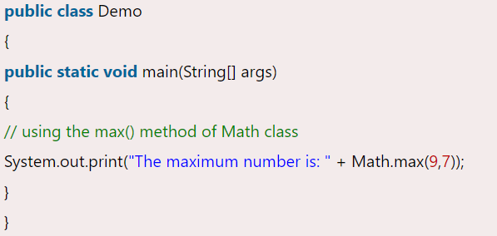
Eg:
we have used three predefined methods main(), print(), and max(). We have used these methods directly without declaration because they are predefined. The print() method is a method of PrintStream class that prints the result on the console. The max() method is a method of the Math class that returns the greater of two numbers.

Slide 19
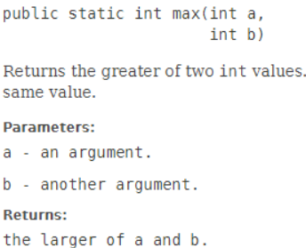
Same method we can write as a User defined

Slide 20
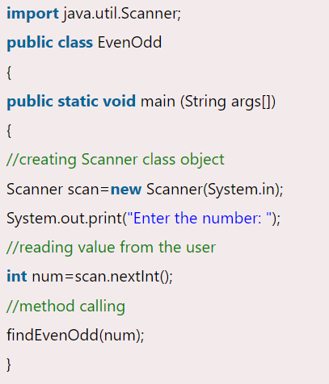
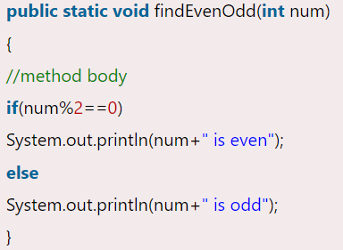
User-defined Method
The method written by the user or programmer is known as a user-defined method. These methods are modified according to the requirement.
How to Create a User-defined Method
Let's create a user defined method that checks the number is even or odd. First, we will define the method.

Slide 21
Static Method
A method that has static keyword is known as static method. In other words, a method that belongs to a class rather than an instance of a class is known as a static method. We can also create a static method by using the keyword static before the method name.
The main advantage of a static method is that we can call it without creating an object. It can access static data members and also change the value of it. It is used to create an instance method. It is invoked by using the class name. The best example of a static method is the main() method. Eg:
public class Display
{
public static void main(String[] args)
{
show();
}
static void show()
{
System.out.println("It is an example of static method.");
}
}

Slide 22
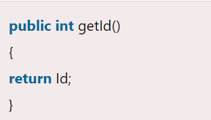
Accessor Method:
Accessor Method: The method(s) that reads the instance variable(s) is known as the accessor method. We can easily identify it because the method is prefixed with the word get. It is also known as getters. It returns the value of the private field. It is used to get the value of the private field.

Slide 23
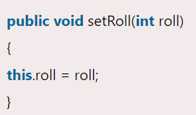
Mutator Method:
Mutator Method: The method(s) read the instance variable(s) and also modify the values. We can easily identify it because the method is prefixed with the word set. It is also known as setters or modifiers. It does not return anything. It accepts a parameter of the same data type that depends on the field. It is used to set the value of the private field.

Slide 24
Abstract Method
The method that does not has method body is known as abstract method. In other words, without an implementation is known as abstract method. It always declares in the abstract class. It means the class itself must be abstract if it has abstract method. To create an abstract method, we use the keyword abstract.

Slide 25
Eg:
abstract class Demo
{
//abstract method declaration
abstract void display();
}
public class MyClass extends Demo
{
//method impelmentation
void display()
{
System.out.println("Abstract method?");
}
public static void main(String args[])
{
//creating object of abstract class
Demo obj = new MyClass();
//invoking abstract method
obj.display();
}
}

Slide 26
Factory method
It is a method that returns an object to the class to which it belongs. All static methods are factory methods. For example, NumberFormat obj = NumberFormat.getNumberInstance();

